Slide 1

Introduction to mininet commands and creating topology
Mohammad Hossein Tabatabaei
Amirkabir University of Technology (Tehran Polytechnic)

Slide 2
Required software (1/2)
VM image of mininet
Virtualization software
An X server
An ssh-capable terminal emulator
You will get all of these on: https://github.com/mininet/openflow-tutorial/wiki/Installing-Required-Software

Slide 3
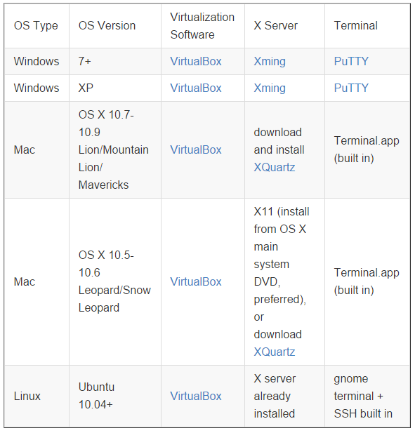
Required software (2/2)

Slide 4
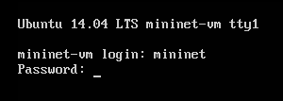
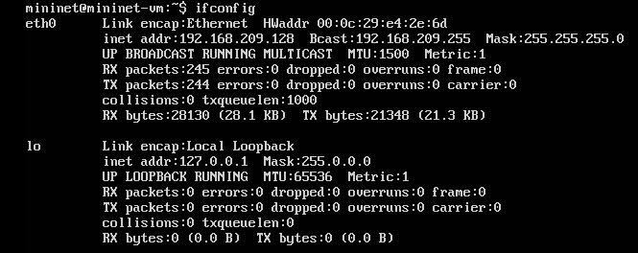
Start up & getting IP address

Slide 5
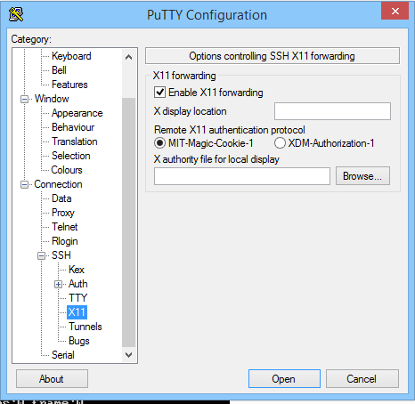
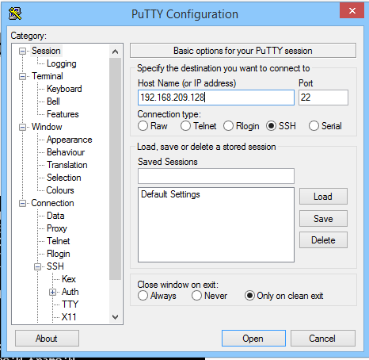
SSH Connection

Slide 6
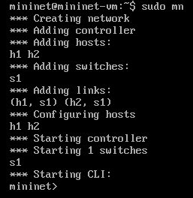
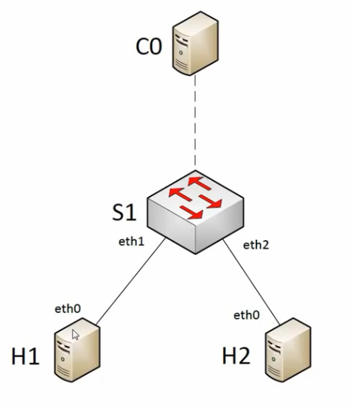
Sudo mn

Slide 7
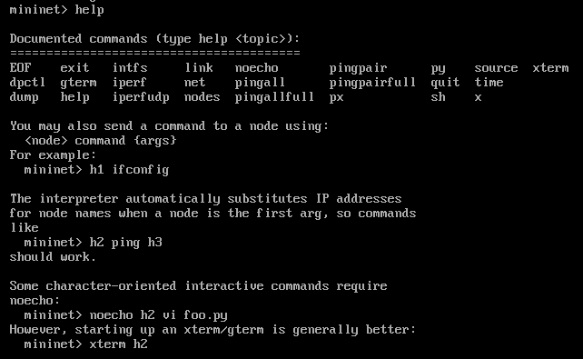
Help to see the list of available command

Slide 8


nodes: to see the list of available nodes
Dump:
List the IP and other info about the nodes

Slide 9

net

Slide 10
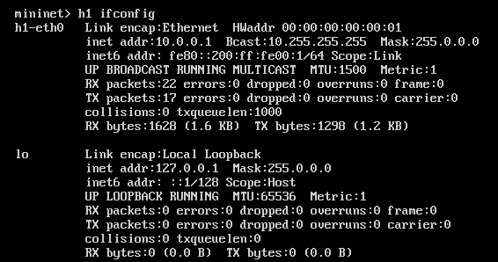
Single command on a node
H1 ifconfig

Slide 11
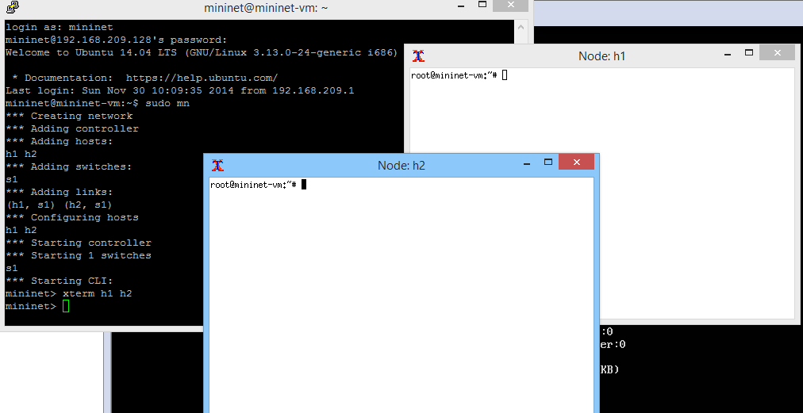
Xterm h1 h2
Better for running interactive commands and watching debug output

Slide 12
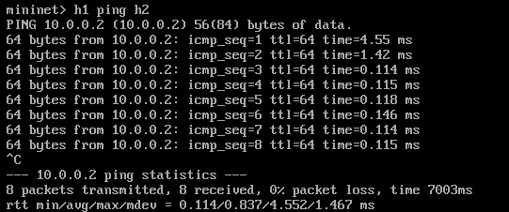

h1 ping h2
pingall

Slide 13


iperf & iperfudp

Slide 14
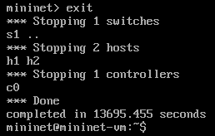
exit

Slide 15
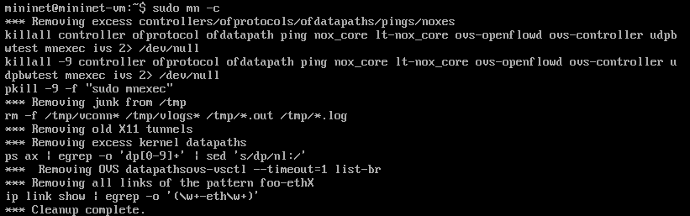
Sudo mn –c Removing all temp files and datapaths

Slide 16
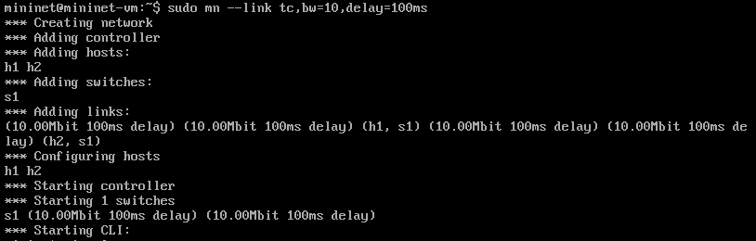

Sudo mn --link tc,bw=10,delay=100ms creating a network with link limitations

Slide 17
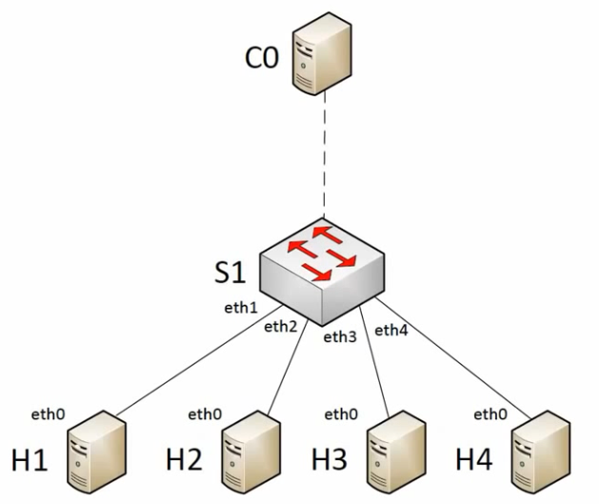
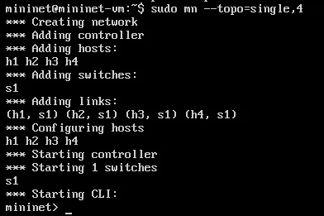
Sudo mn --topo=single,4

Slide 18
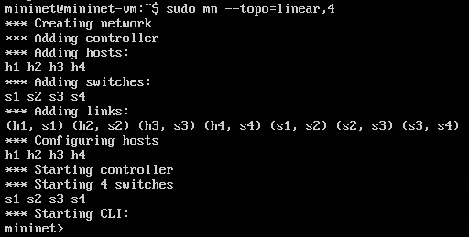
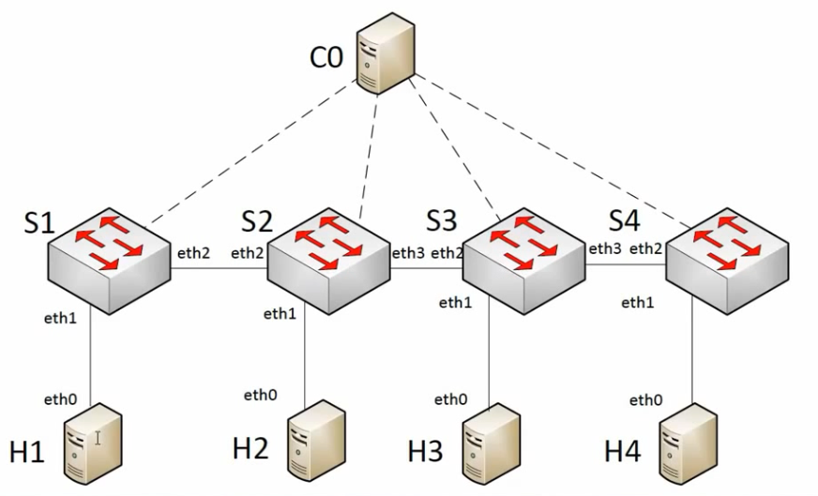
Sudo mn --topo=linear,4

Slide 19
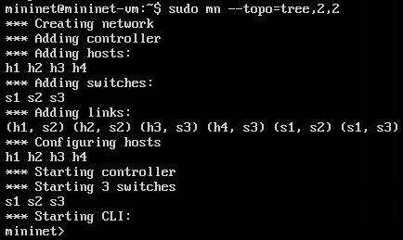
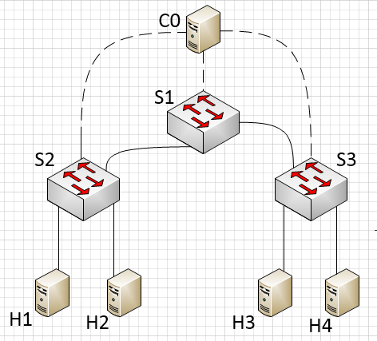
Sudo mn --topo=tree,2,2

Slide 20
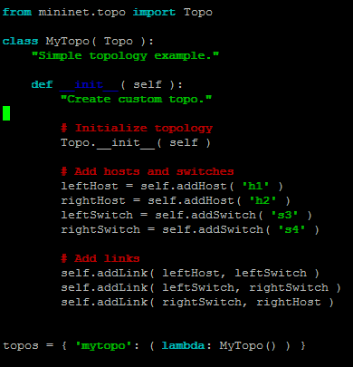
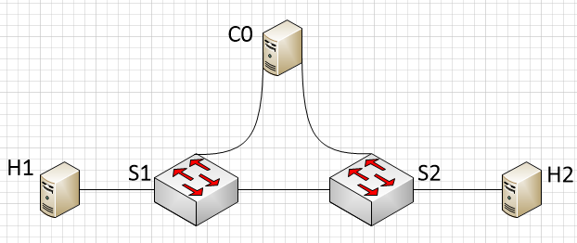
Create custom topology(Example1)

Slide 21
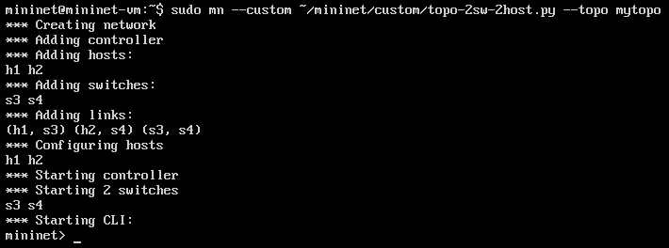
Create custom topology(Example1)

Slide 22
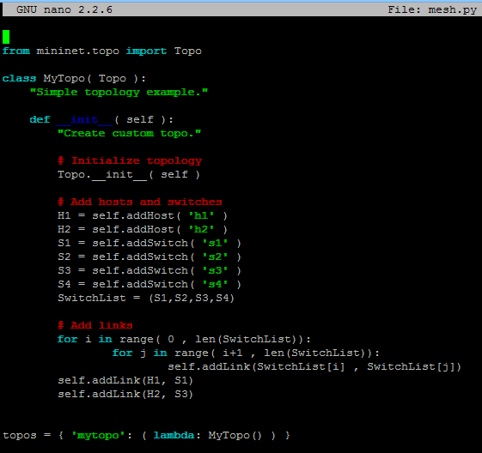
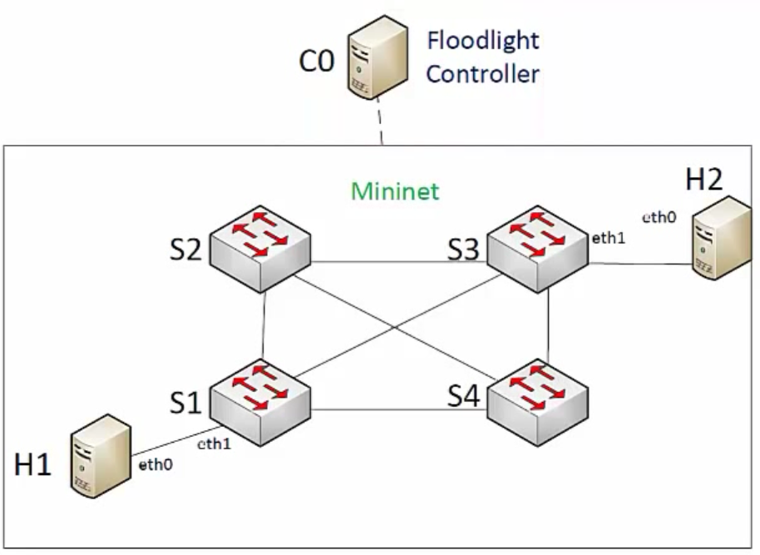
Create custom topology(Example2)

Slide 23
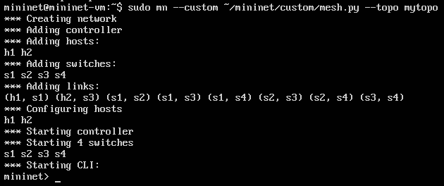
Create custom topology(Example2)
Hosts don’t ping each other in this case! Why?!
To be continued…

